Slide 1

Vel Tech Rangarajan Dr. Sagunthala R&D Institute of Science and Technology
School of Computing
Department of Computer Science and Engineering
10211CS224 / FULL STACK APPLICATION DEVELOPMENT (JAVA)
END SEMESTER PROJECT REVIEW
Date: 06-05-2026
Smart Campus Event Management System
SDG: SDG No – SDG 4 – Quality Education
Presented By:
M. V. Akshaya – VTU25623 – Reg.No.23UECS0975
Courses Handling Faculty:
Dr. M. Mageshwari-M.E, ph.D

Slide 2
INTRODUCTION
1
Background of the Problem-
Many colleges still manage events manually, which leads to confusion, delays, and errors.
There is no centralized system to track events, registrations, or updates efficiently.
Why this Project is Important-
This project helps in digitizing the event management process.
It reduces manual work, saves time, and improves coordination between organizers and participants.
Real-World Relevance-
Event management systems are widely used in universities, companies, and organizations to handle events smoothly.
This project reflects real-world applications of modern web-based systems.
Brief Overview of the System-
The Smart Campus Event Management System is a platform that allows users to create events, register participants, and send notifications.
It centralizes all event-related activities, making management simple and efficient.
2
3
4
5
6
7
8
9

Slide 3
PROBLEM STATEMENT
1
In many colleges, event management is still handled manually or through scattered platforms.
This leads to inefficiency in handling registrations, schedules, and participant data.
Students often miss important updates due to lack of proper communication channels.
Organizers face challenges in tracking attendance and managing event logistics.
Manual processes increase the chances of errors and data mismanagement.
There is no centralized system to streamline all event-related activities.
Hence, there is a need for a simple, reliable, and automated system.
Such a system can improve efficiency, accuracy, and overall event management experience.
2
3
4
5
6
7
8
9

Slide 4
OBJECTIVE(S)
1
To develop a centralized platform for managing all campus events efficiently.
To automate event creation, registration, and participant tracking processes.
To reduce manual work, errors, and time consumption in event management.
To provide real-time notifications and updates to users.
To improve communication between organizers and participants.
To ensure secure and organized storage of event-related data.
To offer a user-friendly interface for easy access and usability.
To generate reports and analytics for better decision-making.
2
3
4
5
6
7
8
9

Slide 5
PROPOSED SYSTEM
How it Solves Existing Issues-
The proposed system addresses the limitations of manual and scattered event management by providing a centralized digital platform.
It automates key processes such as event creation, registration, and participant tracking, which reduces human errors and saves time.
Real-time notifications keep users informed about event updates, while organized data storage helps organizers manage information efficiently.
This improves coordination and ensures smooth execution of events.
Advantages over Current Systems-
Compared to traditional methods, the system is faster, more accurate, and reliable.
It reduces paperwork and minimizes the risk of data loss through secure digital storage.
The user-friendly interface makes it accessible to both organizers and participants.
Additionally, it offers reporting and analytics features, enabling better planning and decision-making, which is not possible with manual systems.
1
2
3
4
5
6
7
8
9

Slide 6
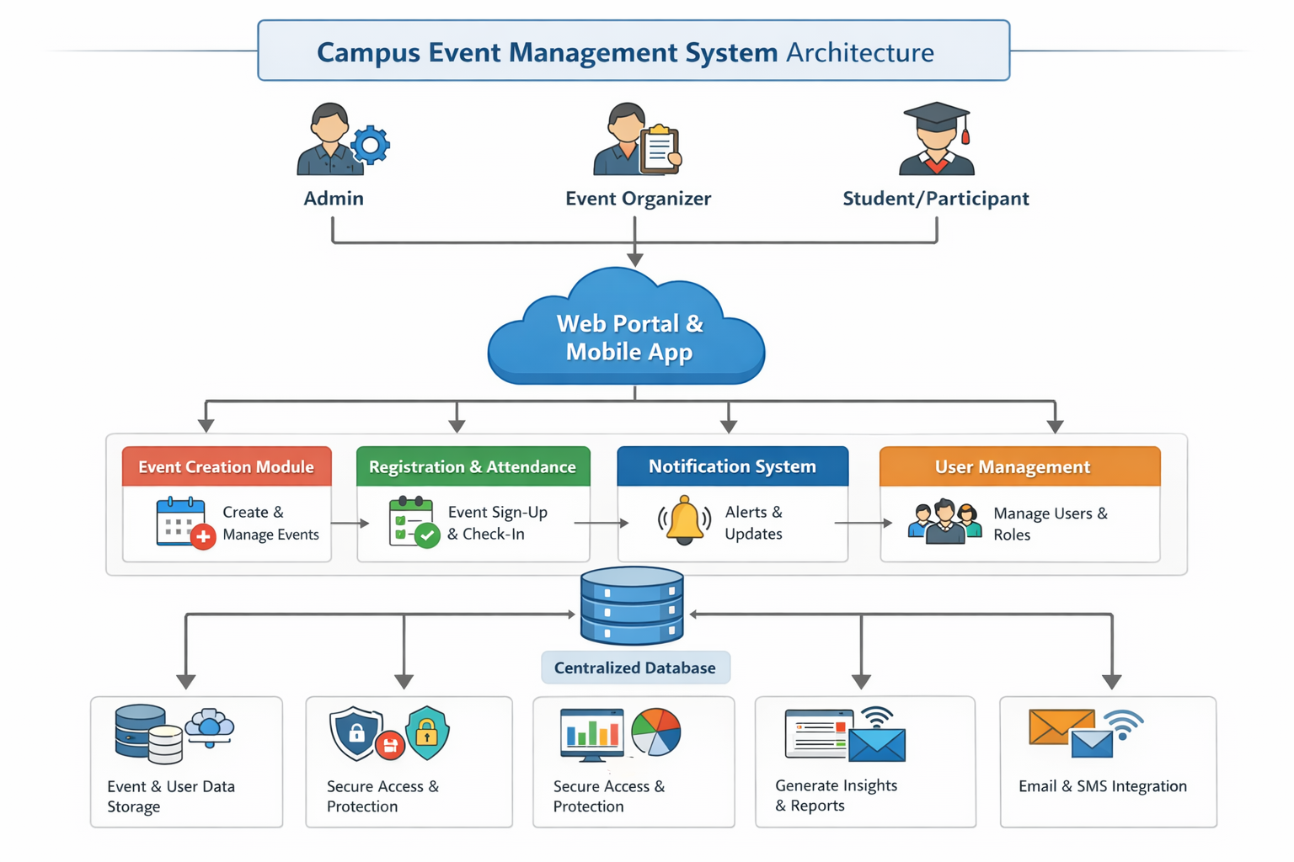
PROPOSED SYSTEM ARCHITECTURE
1
2
3
4
5
6
7
8
9

Slide 7
PROPOSED SYSTEM ARCHITECTURE
Input-
The input includes user actions such as event creation by admins, student registrations, login details, and event-related data.
Users provide this information through the web or mobile interface.
Processing-
The system processes the input by validating user data, managing event details, handling registrations, and generating notifications.
It applies business logic to ensure smooth functioning of all operations.
Database-
All data such as user details, event information, registrations, and transaction records are stored in a centralized database.
It ensures secure storage, easy retrieval, and data consistency.
Output-
The system provides outputs like event confirmations, registration status, notifications, reports, and dashboards.
These outputs help users stay informed and assist organizers in decision-making.

Slide 8
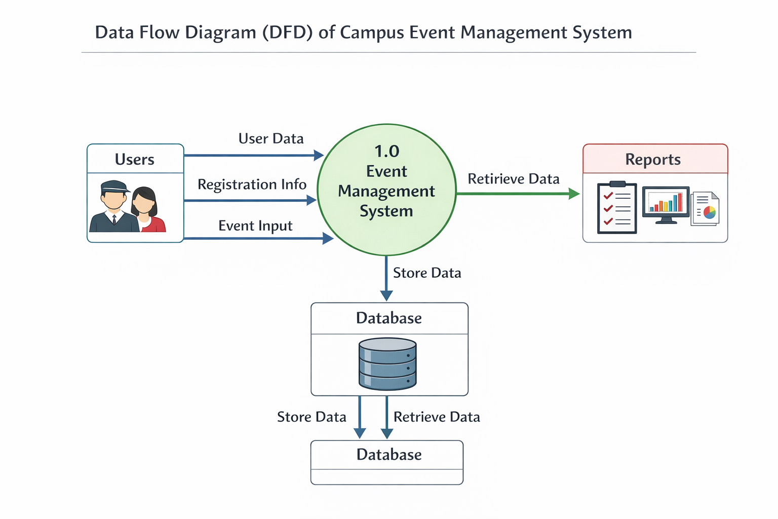
WORKFLOW
1
2
3
4
5
6
7
8
9

Slide 9
TECHNOLOGIES USED
Frontend: HTML, CSS, JavaScript (React/Angular).
Backend: Java (Spring Boot) / Node.js.
Database: MySQL / PostgreSQL.
Third-Party API: Email/SMS APIs, Payment Gateway.
Tools: VS Code/Eclipse, GitHub, Postman.
Hardware/Software Requirements: 4GB RAM, system with internet, browser, JDK/Node.js, database.
1
2
3
4
5
6
7
8
9

Slide 10
MODULE DESCRIPTION
Module 1: User Management: Handles registration, login, roles, and profiles.
Module 2: Event Management: Manages event creation, updates, scheduling, and registrations.
Module 3: Database Management: Stores user, event, and registration data securely.
Module 4: Notification Module: Sends email/SMS updates and reminders.
Module 5: Reporting & Analytics: Generates reports and dashboards for insights.
1
2
3
4
5
6
7
8
9

Slide 11
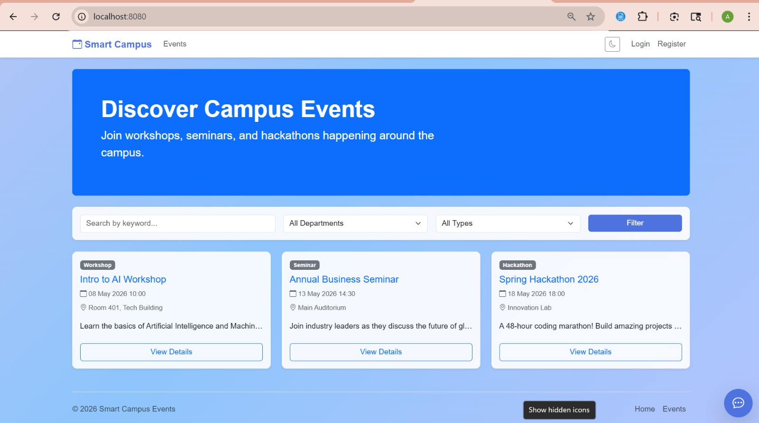
IMPLEMENTATION SCREENSHOTS
Home Page:
1
2
3
4
5
6
7
8
9
Displays an overview of the system with navigation to different features.
Provides basic information about events and easy access to login/registration.

Slide 12
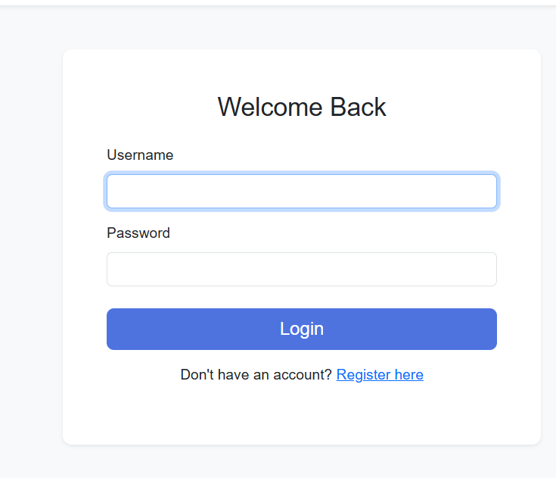
IMPLEMENTATION SCREENSHOTS
Login Page:
1
2
3
4
5
6
7
8(A)
9
Allows users to securely log in using credentials. Authenticates users and redirects them based on their roles.

Slide 13
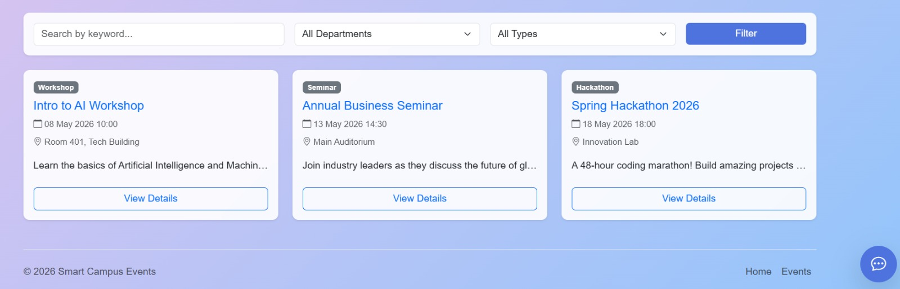
IMPLEMENTATION SCREENSHOTS
Main Module:
Handles core functionalities like event creation, registration, and management.
Enables users to interact with the system efficiently.
Notes:
jjj

Slide 14
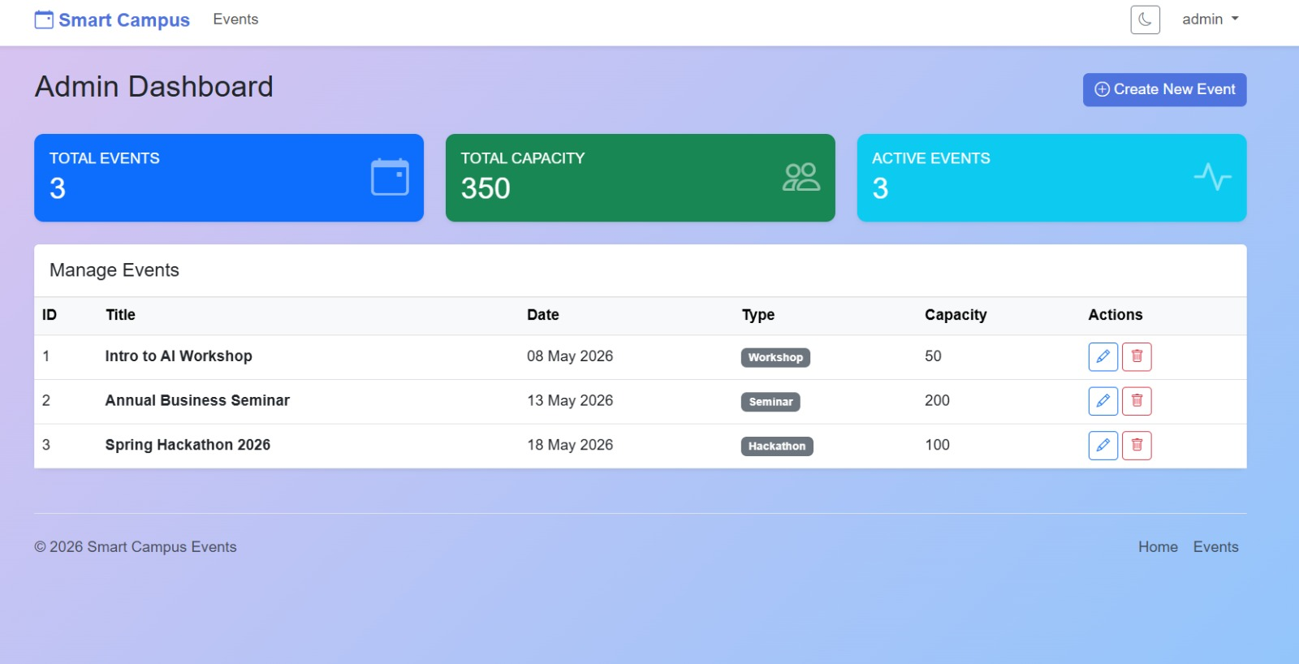
IMPLEMENTATION SCREENSHOTS
Output Page:
Displays results such as event details, registration status, and reports.
Provides confirmation messages and useful insights to users.

Slide 15
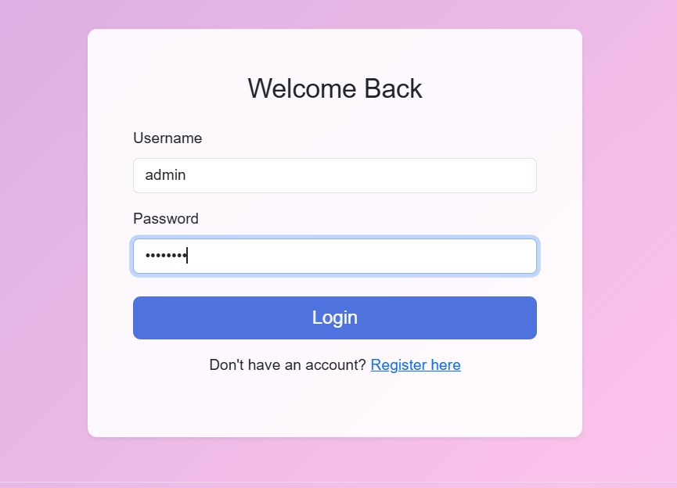
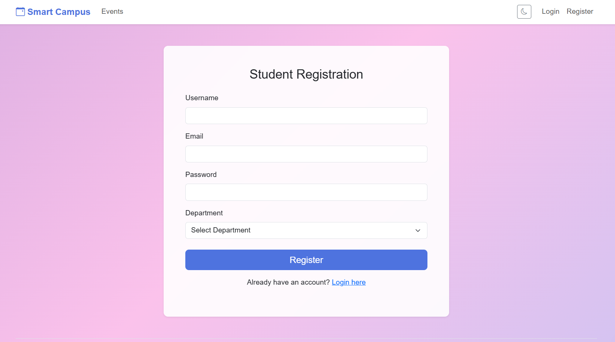
IMPLEMENTATION SCREENSHOTS
Admin Login Page
User Login Page
1
2
3
4
5
6
7
8(B)
9

Slide 16
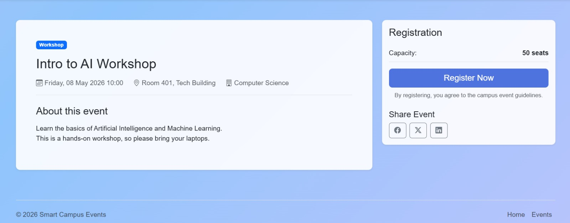
IMPLEMENTATION SCREENSHOTS
Module 1 Screenshot:
1
2
3
4
5
6
7
8(C)
9
The Event Detail page for the "Intro to AI Workshop" presents all relevant information a student needs before registering.

Slide 17
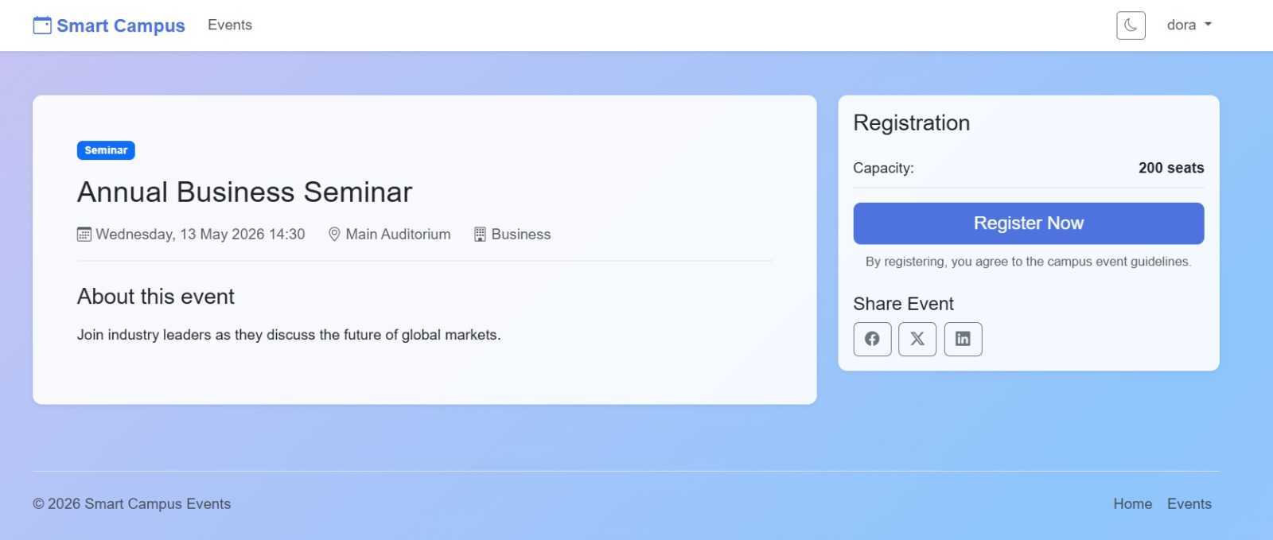
IMPLEMENTATION SCREENSHOTS
Module 2 Screenshot:
1
2
3
4
5
6
7
8(C)
9
The image shows a clean and modern web interface for a Smart Campus Event Management System.
The page is focused on a specific event titled “Annual Business Seminar.”

Slide 18
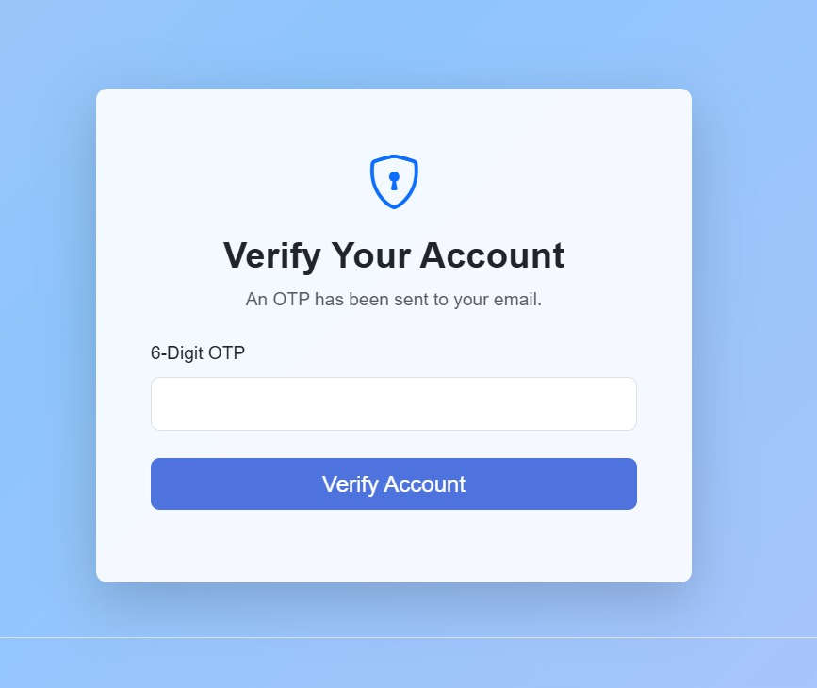
IMPLEMENTATION SCREENSHOTS
1
2
3
4
5
6
7
8(C)
9
After submitting registration details, a 6-digit One-Time Password is dispatched to the student's registered email address for identity confirmation.

Slide 19
ADVANTAGES & LIMITATIONS
Advantages:
Automates event management, saving time and effort.
Reduces errors compared to manual systems.
Centralized platform for easy access to all event data.
Provides real-time updates and notifications.
Improves communication between organizers and participants.
Limitations:
Requires internet connection to access the system.
Initial setup and development cost can be high.
Depends on system maintenance and updates.
Security risks if not properly implemented.
Users may need basic technical knowledge to operate.
1
2
3
4
5
6
7
8
9

Slide 20
Thank you

